Slide 1
MATLAB for image processing Session 4: Figures and plotting

Slide 2
Course structure
Session 1
Introduction to MATLAB
Data types
Conditional statements and loops
Session 3
Advanced data structures
Object-oriented programming
Advanced image reading (Bio-Formats)
Session 2
Arrays and matrices
Image processing
Session 4
Figures and plotting
Designing a user interface

Slide 3

Under construction!
Comments/requests?
Let me know!
stephen.cross@bristol.ac.uk

Slide 4
Figures
Notes:
Convert this into 2 spider diagrams if there’s time

Slide 5
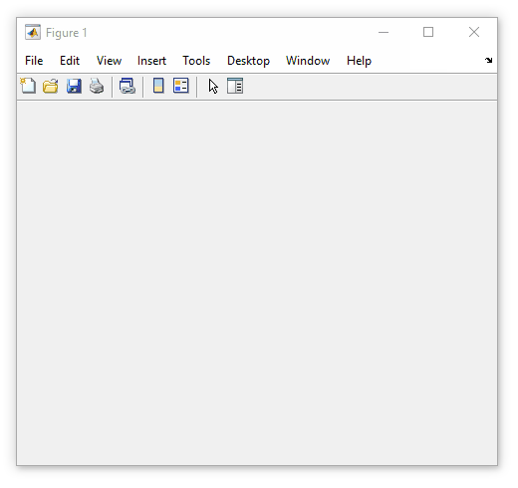
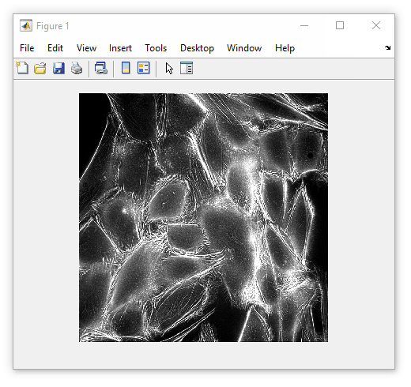
Introduction to figures
All graphical components live within a figure
The figure object is simply a container window
A figure is an object (Session 3)
Properties include
Name (title)
Position (location on screen)
Methods include
delete (close window)
We’ve used figures when viewing images
my_fig = figure()
imshow(some_image, [])

Slide 6
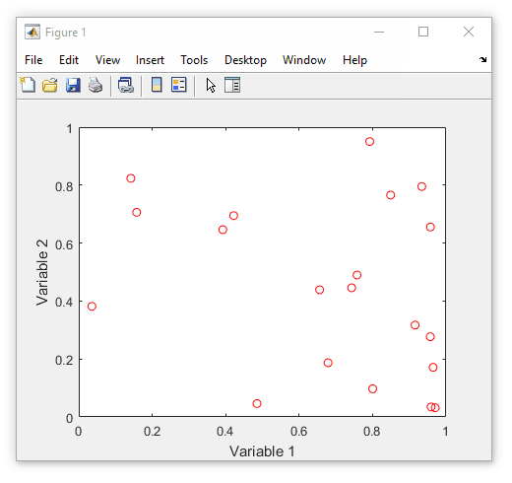
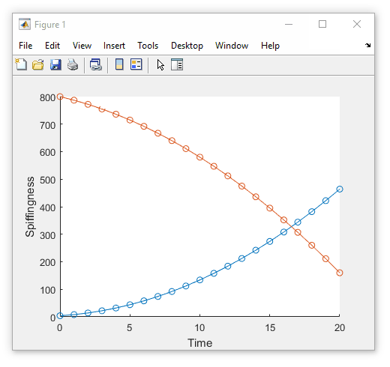
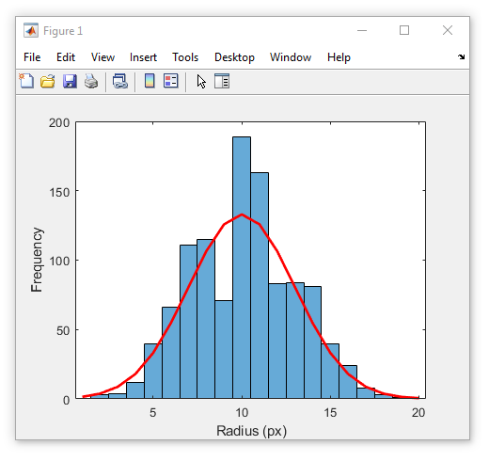
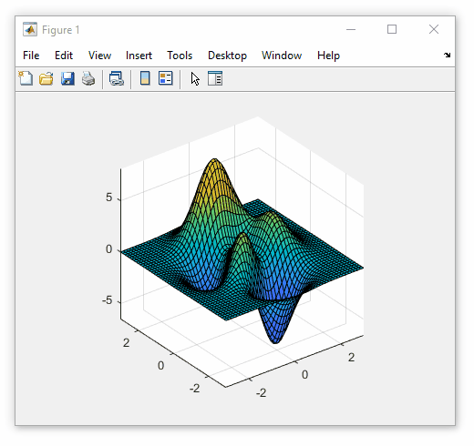
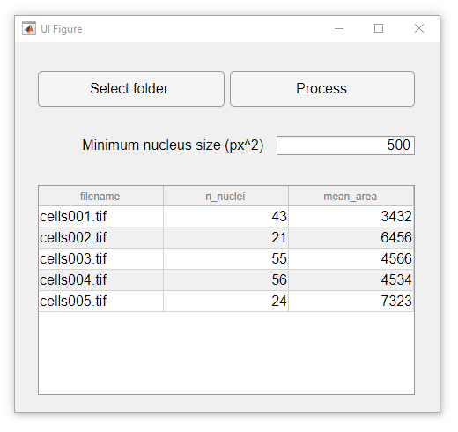
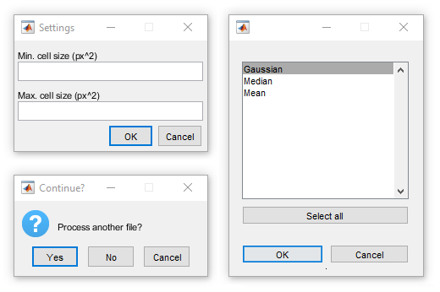
What can go in a figure?
Images
Data plots
User controls
Notes:
Figure size = [758 558 482 365]

Slide 7
Some handy figure functions
Before we go further, here are some handy commands
Get current figure (gcf)
Get a reference to the active figure
Clear current figure (clf)
Go back to a blank figure window
Close current figure (close)
Close all windows with close all

Slide 8
Plotting
Notes:
Convert this into 2 spider diagrams if there’s time

Slide 9
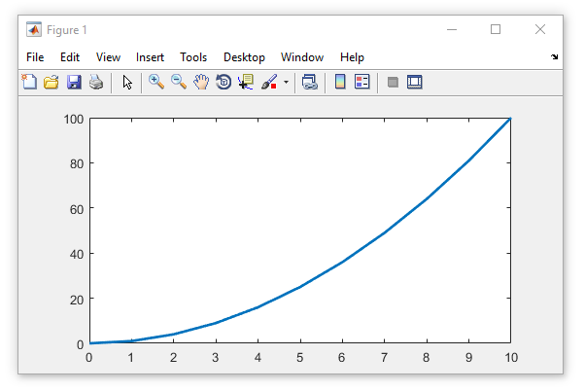
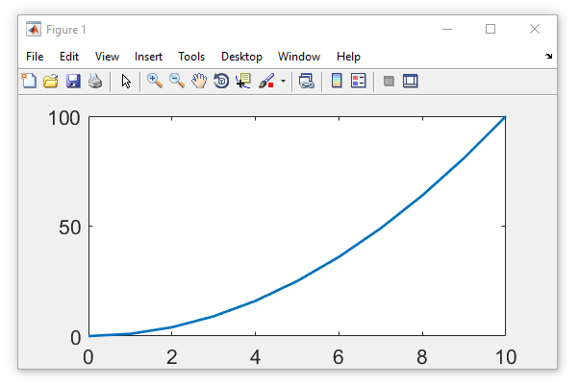
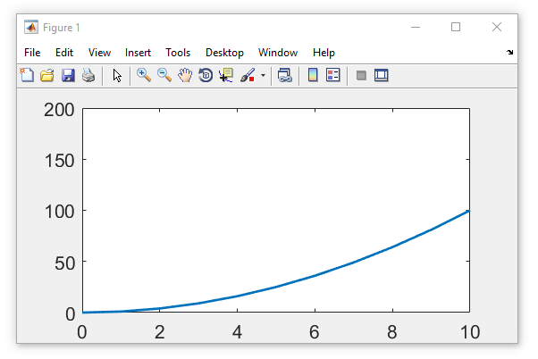
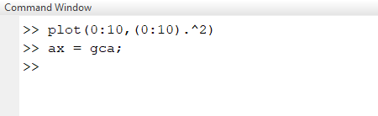
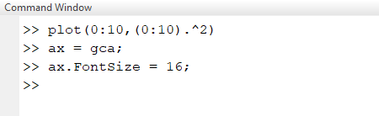
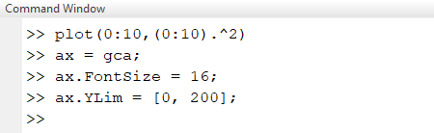
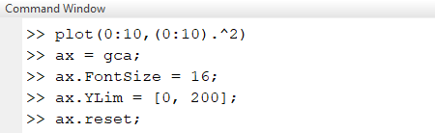
Axes
Plots are drawn inside axes
Automatically created when plotting
Get reference to active axes using gca
Axes are an object
Properties include
XLim and YLim (axis limits)
Position (location on screen)
Methods include
delete (remove axes)
reset (return to default settings)

Slide 10
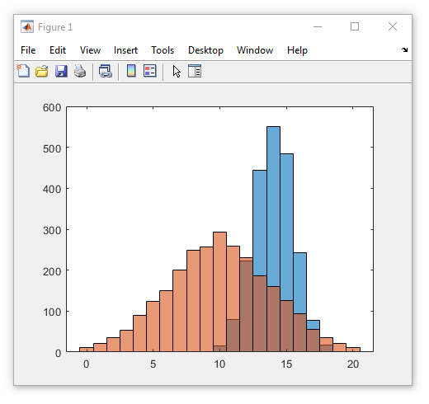
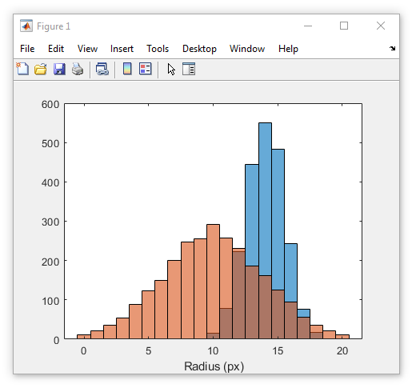
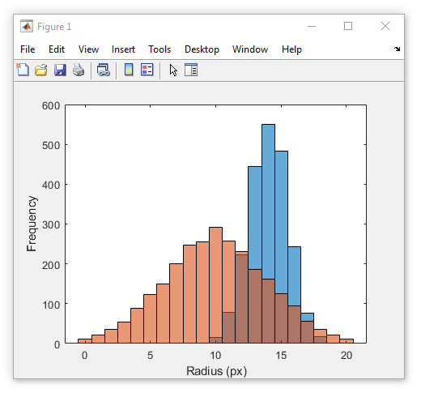
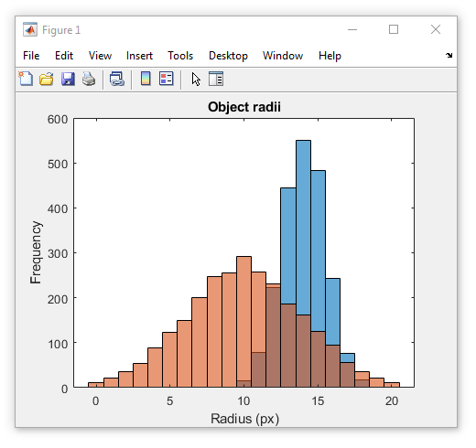
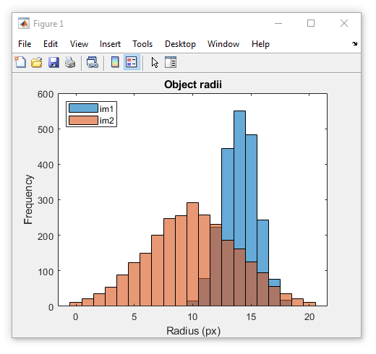
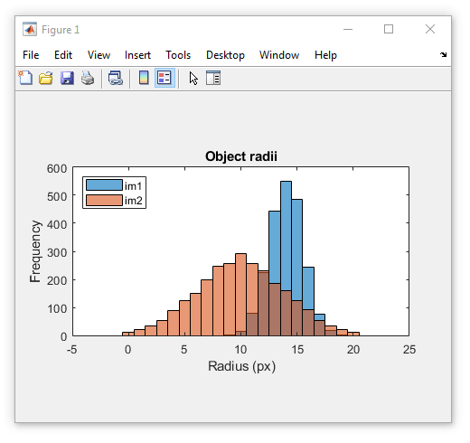
Axes
Quick commands for axis formatting
xlabel (add x-axis label)
ylabel (add y-axis label)
title (add title above plot)
legend (add legend)
This is an object
Set axis aspect ratio with daspect
Always a 3-element vector
Specifies relative length of each axis
leg_obj = legend(‘im1, ‘im2’)
leg_obj.Location = ‘northwest’
xlabel(‘Radius (px)’)
ylabel(‘Frequency’)
title(‘Object radii’)
daspect([1 40 1])

Slide 11
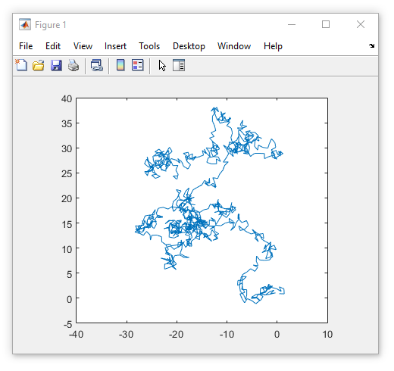
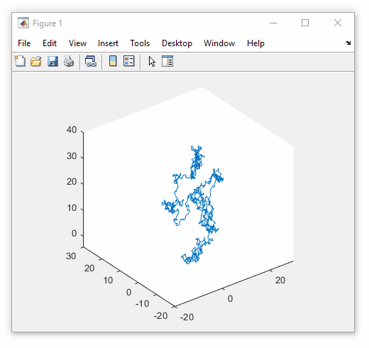
XY (and XYZ) plots
Create a 2D scatter plot with plot
plot(diff_x, diff_y)
Create a 3D scatter plot with plot3
plot3(diff_x, diff_y, diff_z)

Slide 12
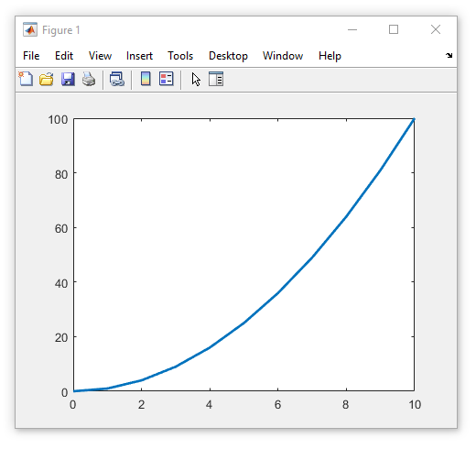
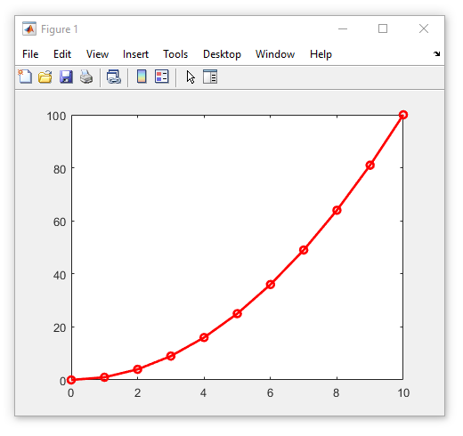
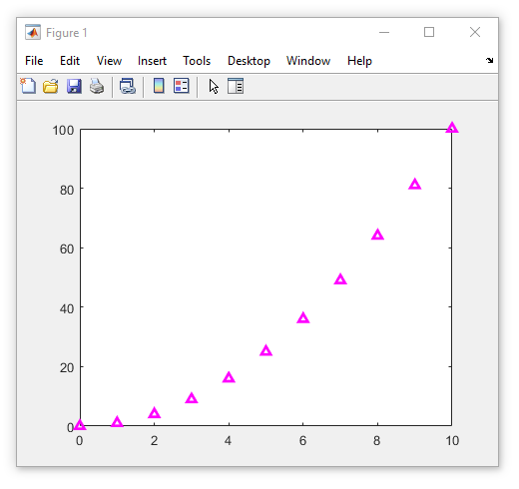
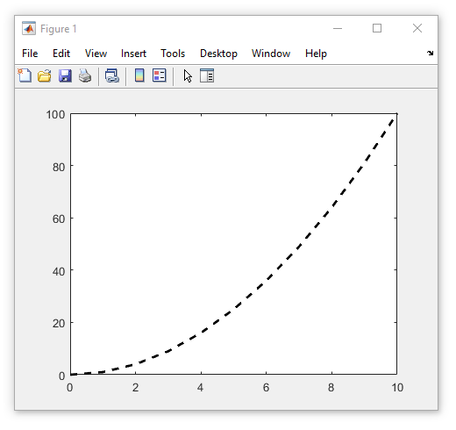
XY (and XYZ) plots
LineSpec argument controls plot rendering
Only one of each (at most)
Spec. | Line style
- | Solid
-- | Dashed
: | Dotted
-. | Dash-dot
Spec. | Marker
o | Circle
+ | Plus sign
d | Diamond
s | Square
* | Asterisk
. | Point
x | Cross
^ | Triangle
Spec. | Colour
k | Black
w | White
r | Red
g | Green
b | Blue
y | Yellow
m | Magenta
c | Cyan
plot(0:10, (0:10).^2, ‘--k’)
plot(0:10, (0:10).^2, ‘m^’)
plot(0:10, (0:10).^2)
plot(0:10, (0:10).^2, ‘ro-’)

Slide 13
XY (and XYZ) plots
Exercise: Using XY plot function
Use plot function to plot x = 1:10 against y = 3x. Use the LineSpec argument to create a dashed cyan line with magenta cross data markers
Add the x and y axis labels “Time (s)” and “Volume (dB)”.
Set the aspect ratio to 1-to-1.

Slide 14
XY (and XYZ) plots
Solution: Using XY plot function
plot(1:10, 3*(1:10), ‘--mx’)
xlabel(‘Time (s)’)
ylabel(‘Volume (dB)’)
daspect([1 1 1])

Slide 15
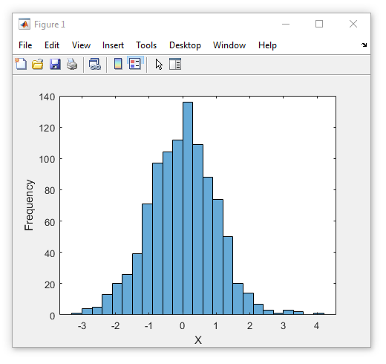
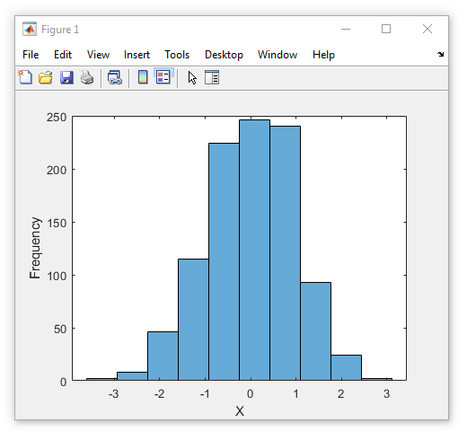
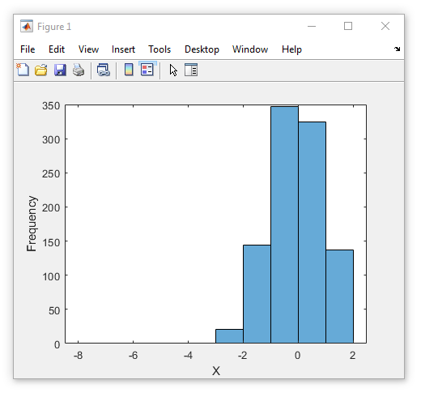
Histograms
Plot histogram using histogram
Example: Gaussian-dist. random numbers
histogram(randn(1000,1))
Can specify bins
Number of bins
histogram(randn(1000,1), 10)
Bins as vector
histogram(randn(1000,1), [-8:2])
Assign return to get values
Disables plot display
histogram(randn(1000,1), [-8:2])
histogram(randn(1000,1))
histogram(randn(1000,1), 10)

Slide 16
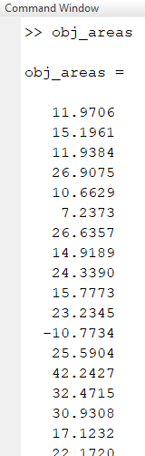
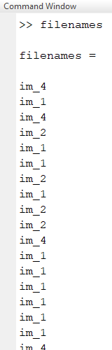
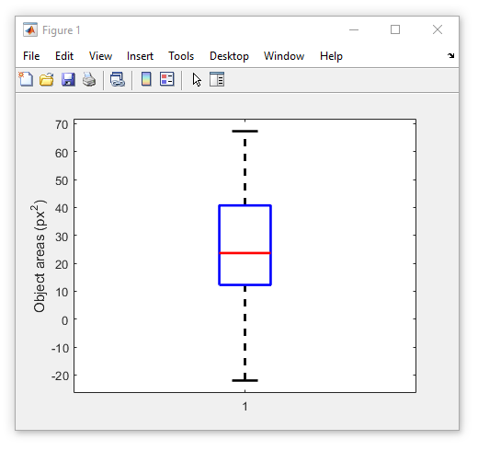
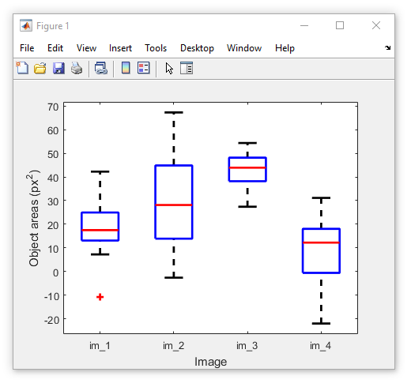
Box and whisker plots
Create box and whisker plot using boxplot
Example data from GitHub (Session 4)
load(‘boxplot_data.mat’)
boxplot(obj_areas)
Group data using second argument
Vector of equal length to input
Each element specifies group
load(‘boxplot_data.mat’)
boxplot(obj_areas, filenames)
boxplot(obj_areas, filenames)
boxplot(obj_areas)

Slide 17
Surface plots
Surface for XY gridded data
Must specify X, Y and Z coordinate matrices
Can create regular XY matrices with meshgrid
A small-scale example (3x4 grid)
X-indices
Y-indices
Z-indices
1 | 2 | 3 | 4 | 5
1 | 2 | 3 | 4 | 5
1 | 2 | 3 | 4 | 5
1 | 2 | 3 | 4 | 5
1 | 1 | 1 | 1 | 1
2 | 2 | 2 | 2 | 2
3 | 3 | 3 | 3 | 3
4 | 4 | 4 | 4 | 4
0 | 0 | 1 | 3 | 2
1 | 2 | 5 | 7 | 4
2 | 4 | 6 | 8 | 3
2 | 4 | 5 | 4 | 3

Slide 18
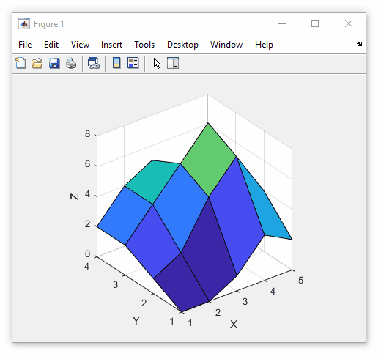

Surface plots
Surface for XY gridded data
Must specify X, Y and Z coordinate matrices
Can create regular XY matrices with meshgrid
A small-scale example (3x4 grid)
X-indices
Y-indices
Z-indices
1 | 2 | 3 | 4 | 5
1 | 2 | 3 | 4 | 5
1 | 2 | 3 | 4 | 5
1 | 2 | 3 | 4 | 5
1 | 1 | 1 | 1 | 1
2 | 2 | 2 | 2 | 2
3 | 3 | 3 | 3 | 3
4 | 4 | 4 | 4 | 4
0 | 0 | 1 | 3 | 2
1 | 2 | 5 | 7 | 4
2 | 4 | 6 | 8 | 3
2 | 4 | 5 | 4 | 3

Slide 19
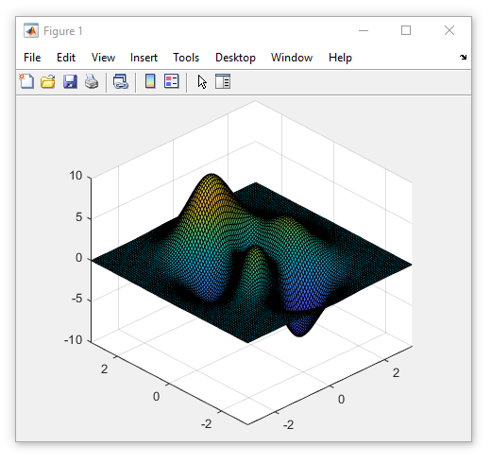
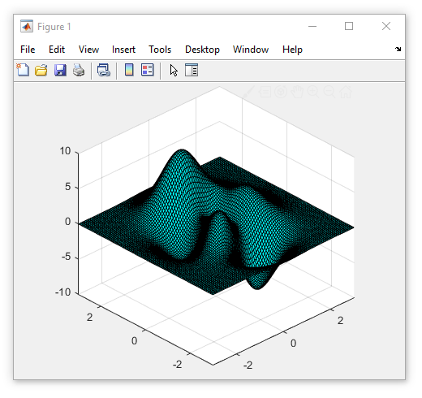
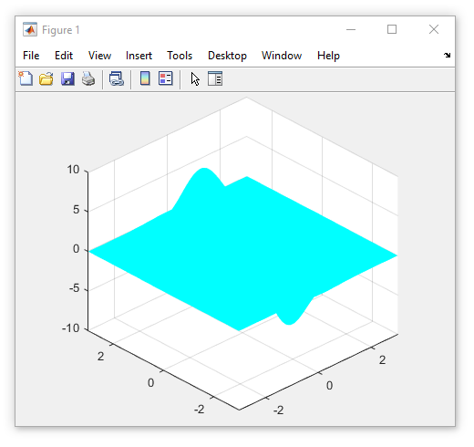
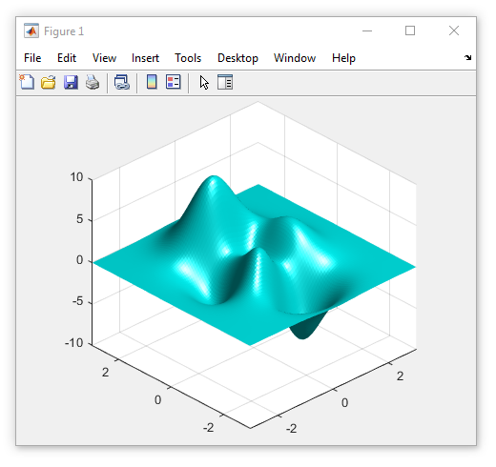
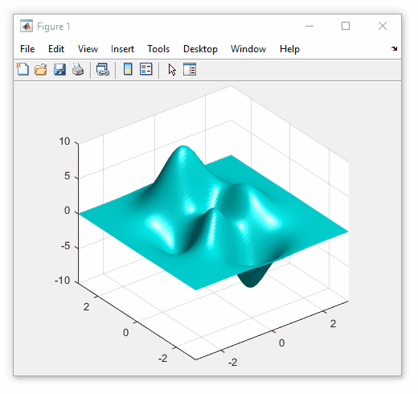
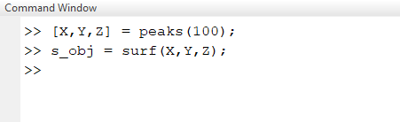
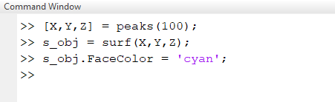
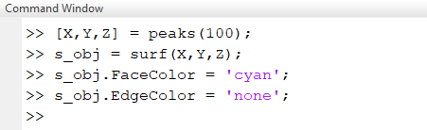
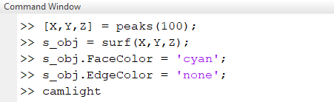
Surface plots
Surface plot is also an object!
Properties include
EdgeColor (colour of lines separating faces)
FaceColor (colour of faces)
FaceAlpha (face opacity, values in range 0-1)
Surface plots can also use “fancy” lighting
Enable with camlight function

Slide 20
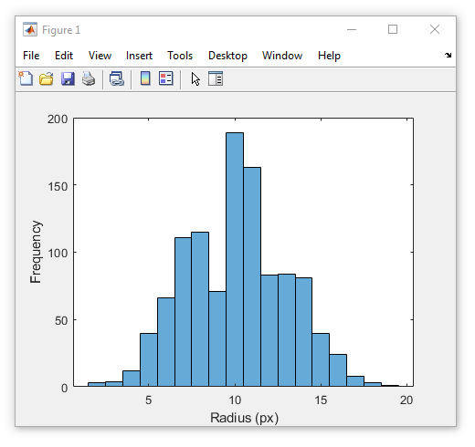
Combining plot types
Combine multiple plots on the same axes using hold on
Stop adding using hold off
Example, histogram and best fit line
Load data from GitHub (Session4)
load(‘multiplot_data.mat’)
Create bar chart and hold on
histogram(radii)
hold on
Add line
plot(x, y_line, 'r-’, 'LineWidth’, 2)

Slide 21
Combining plot types
Exercise: Displaying two overlaid histograms
Use the following commands to generate two sets of Gaussian-distributed values
vals_1 = 5 + randn(1000,1)*2
vals_2 = 1 + randn(1000,1)*4
Display the first set (vals_1) as a histogram with 21 bins in the range -10 to 10
Now, add a the second set of values to the same plot

Slide 22
Combining plot types
Solution: Displaying two overlaid histograms
vals_1 = 5 + randn(1000,1)*2
vals_2 = 1 + randn(1000,1)*4
histogram(vals_1, [-10:10])
hold on
histogram(vals_2, [-10:10])

Slide 23
Designing a user interface
Notes:
Convert this into 2 spider diagrams if there’s time

Slide 24
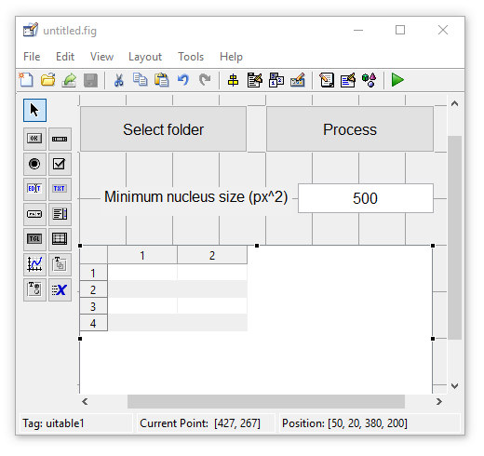
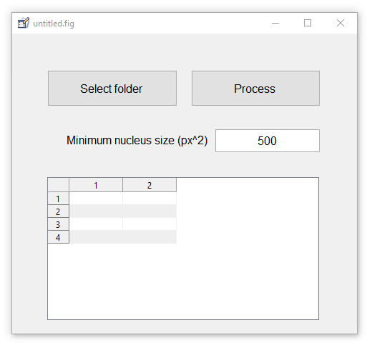
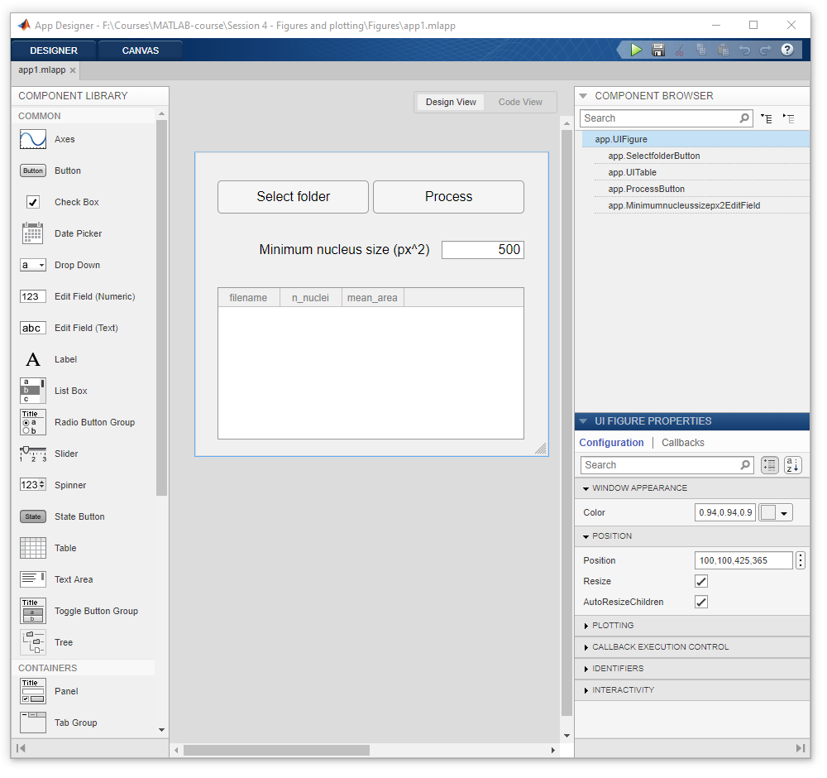
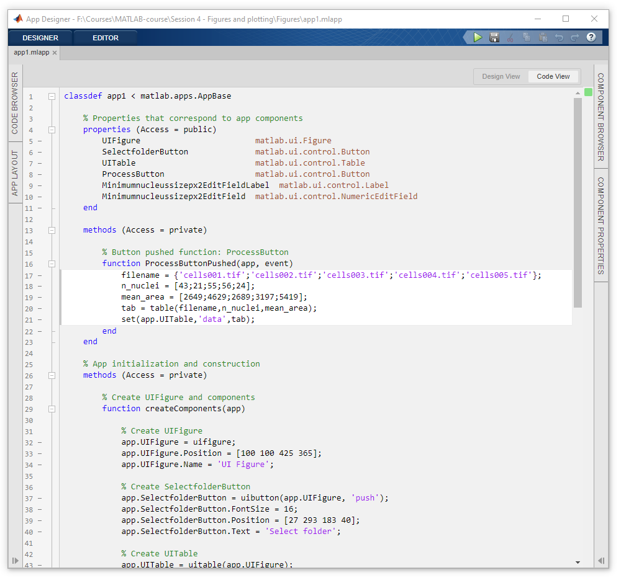
Graphical user interfaces (GUIs)
MATLAB has three main methods for generating GUIs
Deprecated
Programatically
GUIDE
App Designer

Slide 25
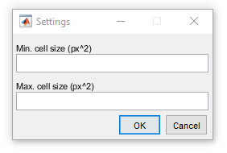


Basic GUI components
Basic controls that pause execution
Execution resumes when control is closed
Question (questdlg)
‘Yes’, ‘No’ or ‘Cancel’
Can use custom options
Returns selected text
Text entry (inputdlg)
Specify questions with cell array of box titles
Returns entered text
Selectable list (listdlg)
Specify options as cell array
Returns selected indices

Slide 26
App Designer
MATLAB’s new GUI creation tool
Easy to use wizard
Drag and drop components
Each is an object
Code for interface auto-generated
Easy to get complex functionality
Add callback functions that run when a component is interacted with
Difficult (?!) to break
Restricted access to core code

Slide 27
0.9
0.4
0.2
0.5
0.7
0
1
1
0
1
rand_arr = rand(5,1)
log_arr = [0; 1; 1; 0; 1]
subset_arr = rand_arr(log_arr)
0.9 | 0.4 | 0.2 | 0.5 | 0.7
0.4
0.2
0.7
0 | 1 | 1 | 0 | 1
0.4 | 0.2 | 0.7

Slide 28






App Designer
Editable code sections shown in white
Use “Code View” to add function code
Wizard to assist first time use
List of components in use
Right-click a component to add callback function
Drag in new components from here
Properties of selected component

Slide 29
Questions?!
Notes:
Convert this into 2 spider diagrams if there’s time

Slide 30
Under construction!
Comments/requests?
Let me know!
stephen.cross@bristol.ac.uk

